Slide 1


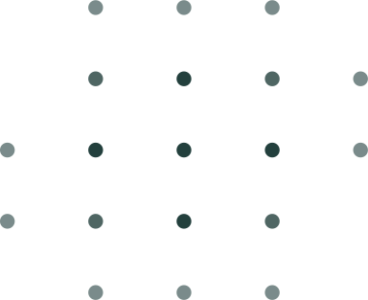



PANTHER SHUTTLE APP
https://yanarex.github.io/shuttle-app-website/
Members: Joseph Hilte, Tony Arrington, Jonathan Suo, and Chase Monigle

Slide 2







Main Objectives
Improved GUI to look better.
Made the GUI look way more user friendly
Implemented a working schedule.
Scrapped the PDF and implemented the schedule
Implemented the beginnings of the mapping system.
Started the mapping system
Implemented a rough draft notification system.
Started the implementation of receiving notifications

Slide 3

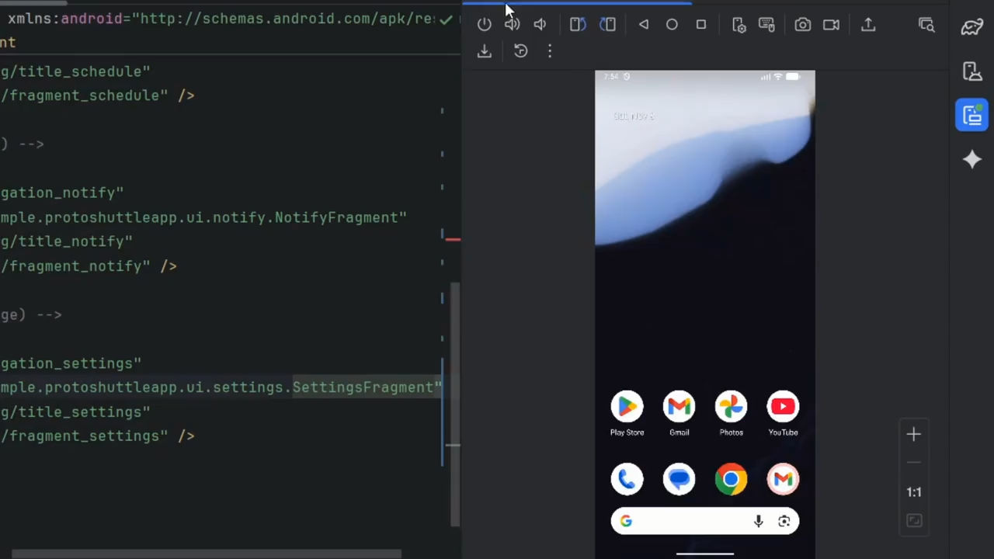



Improved GUI

Slide 4
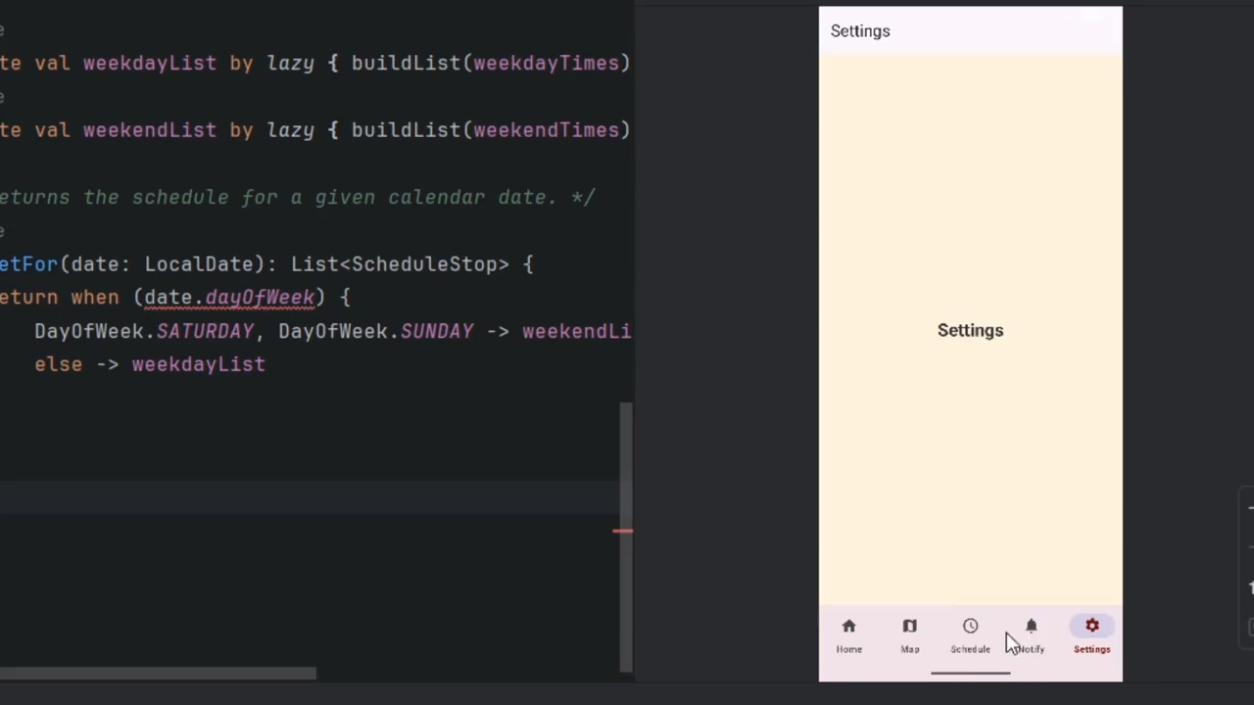

PDF Schedule

Slide 5
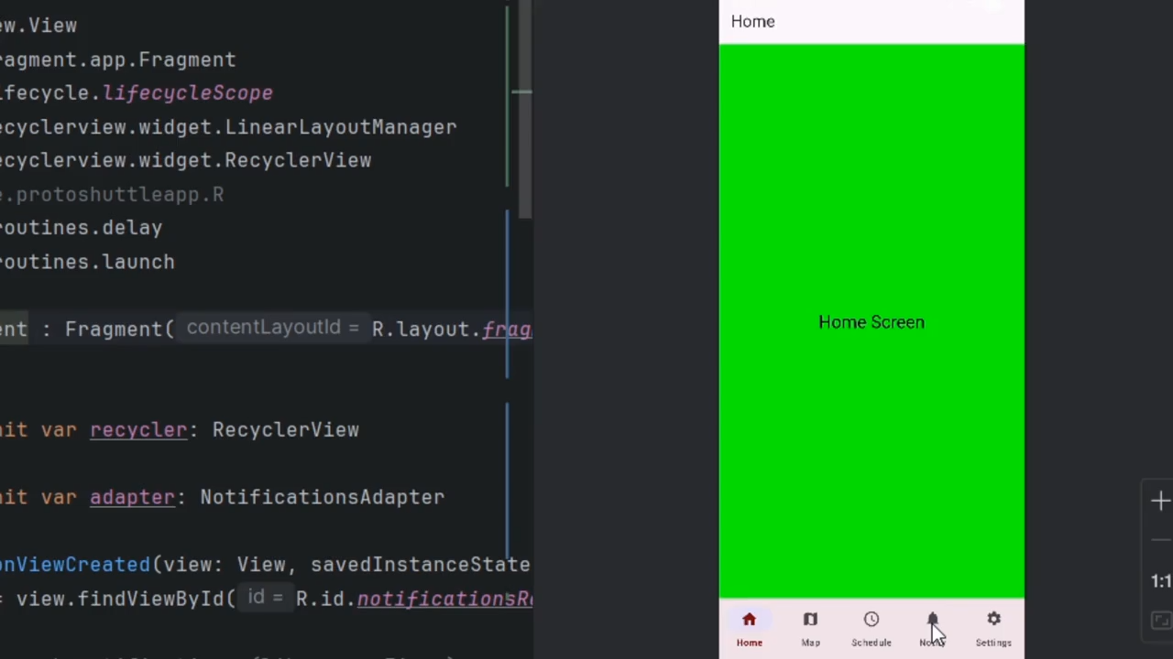

Notifications

Slide 6
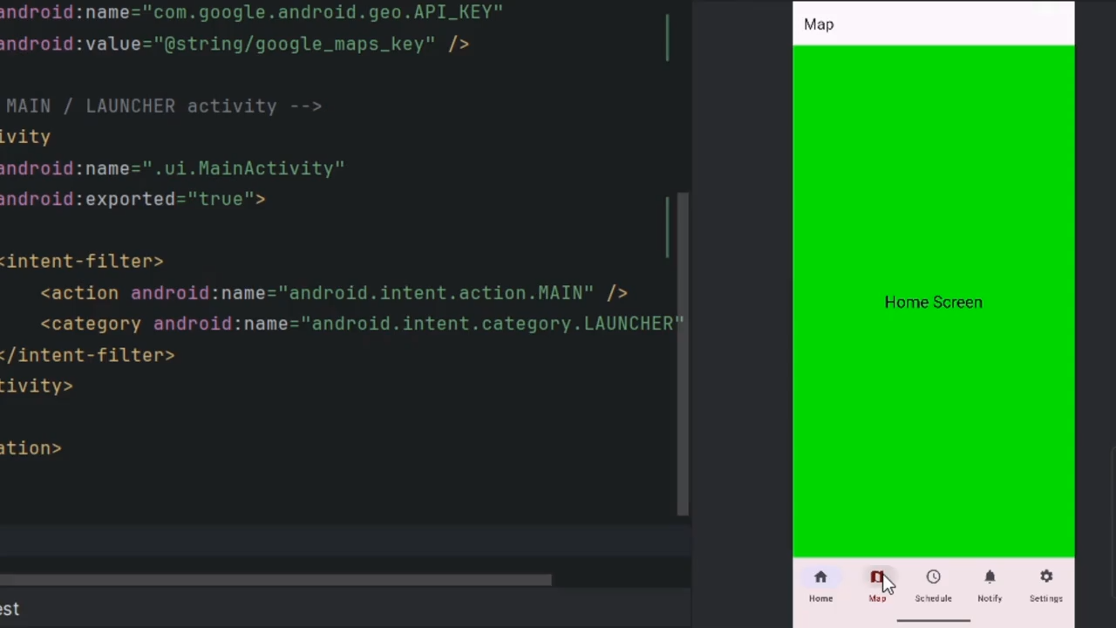

Mapping

Slide 7
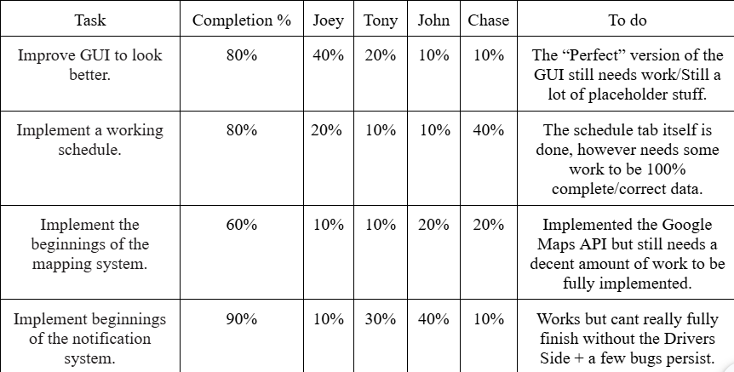


Milestone 3 Progress

Slide 8
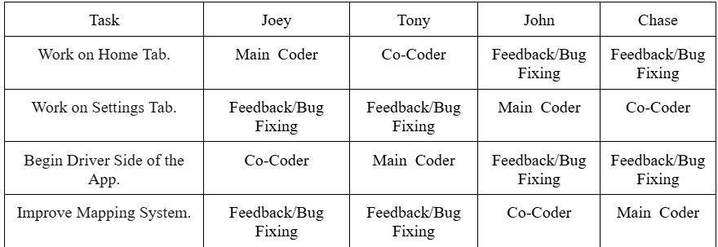
Milestone 4 Plan

Slide 9






QUESTIONS?
Visit our website
https://yanarex.github.io/shuttle-app-website/

